Slide 1
Project Management System
Part 2
Viswanathan Hariharan

Slide 2
Estimation
Basic steps of estimation are
Estimate size of the software
Convert the size into effort (person-months)
Distribute the effort across various phases of the project such as Design, Coding, Testing
Estimate the schedule for the project

Slide 3
Software Size
Size measures should be easy to use early in the project
Also the measure should be such that we should be able to readily measure the size once the work is completed
Examples of size measures are:
  Lines of code (LoC)
  Function Points
LoC are hard to relate to functional requirements but are easy to measure once the software in developed
Function points are easy to estimate (because it starts from user’s perspective). However it is hard to measure given a program code
So we generally convert the FP to LoC, based on historical data

Slide 4
Function points (FP): High level approach
Examine application requirement to determine the # of functions and their complexity level
  Different types of functions are:
    External Input
    External Output
    Inquiry
    Internal files
    External files
  Complexity levels can be Simple, Medium, High
Assign FPs to each Function & each File based on its complexity
Total the FPs. This is called Unadjusted FP or Raw FPs
Adjust total FPs by + or – 35% depending on the characteristics of the system, such as level of fault tolerance needed, level of distributed computing, level of performance, etc.

Slide 5
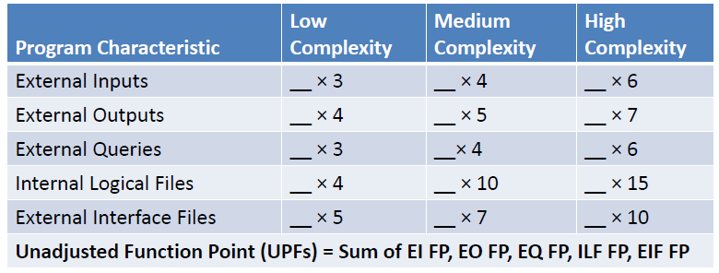
FPs for Functions & Files
Here are the FPs for different types of functions and files, based on their complexity

Slide 6
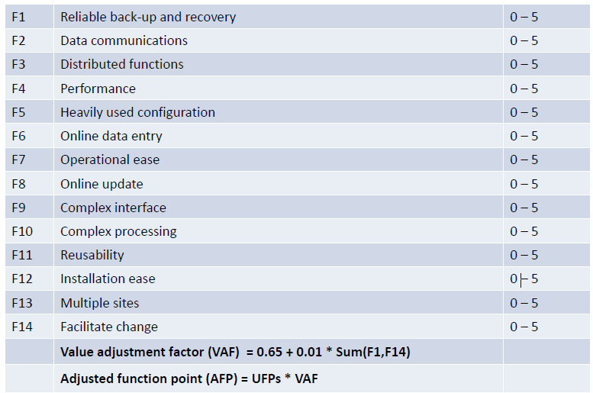
14 Software characteristics

Slide 7
Example of FP calculation
Functions | Name of Function | Type | Complexity | FP
 | Inquire balance | EQ | Low | 3
 | Withdraw money | EI | Medium | 4
 | Generate statement | EO | High | 7
 | ...
 | ...
Files | Name of File | Type | Complexity | FP
 | Account file | ILF | Medium | 10
 | Transaction file | ILF | Low | 4
 | TDS rates | EIF | Medium | 7
Total FPs (unadjusted) |  |  |  | 35
Adjustment factor |  |  |  | 1.1
Adjusted FP |  |  |  | 38.5

Slide 8
Estimating inaccuracies
Regardless of the method used, estimates are inaccurate
Most estimates have erred in being too low
This results in last minute crisis, late delivery and poor quality

Slide 9
Estimation inaccuracies…
Use multiple estimators and compare them (Wideband Delphi technique)
Earlier the estimate (in the lifecycle) less is known about the product, greater the inaccuracies
Hence add contingency depending on stage of development
Completed Project Phase | Code Growth Range %
Requirements | 100-200
High-level design | 75-100
Detailed design | 50-100
Implementation | 25-50
Function test | 10-25
System test | 0-10

Slide 10
Estimation inaccuracies…
Each organization needs to accumulate its own historical data and develop its own contingency factors
Industry data may be available. However these may or may not be applicable to your organization
How do you estimate size of software in your organization?

Slide 11
Productivity factors
We need productivity factor to convert size into effort (programmer months)
Ex. of productivity factor: 100 LoC per programmer day or 8 hours per FP from design to testing
Productivity varies by
  Type of software product (business appl, system software, real time system, data analytics software, networking software, etc.)
  Technology used to develop software – Java, C++, Client – Server, Web technology, Mobile app
  Program size – bigger the program, higher the coordination effort, lower the productivity
  % of programs being changed during enhancement Ex. Product enhancement productivity is 70% of new development and Maintenance productivity is 25% of new development
  Have you come across any other factors that impact productivity?

Slide 12
Productivity factors…
Each organization should gather its own productivity data
  Different types of data to be gathered are effort for each type of activity such as
  Design,
  Coding,
  Testing,
  Reviews
  Rework,
  Training,
  Project management, etc.
  and the corresponding sizes such as FP, LoC, # test cases, # defects, etc.
Categorize products / projects by type of software (Business app, Real time system, etc.), size, domain, technology, etc. to arrive at average productivity of each type of project

Slide 13
Scheduling
Project schedule can be developed by spreading the effort over the planned product development phases
For example:
  20% for analysis & design
  45% for construction (coding)
  20% for testing (Integration test + System test)
  5% User acceptance test
  10% for Project management
As the requirements are not known at the beginning, it is difficult to estimate the effort for requirement gathering phase

Slide 14
Distribution across phases
Phase-wise distribution of resource
Phase | Small project (2000 Loc) | Large project (128,000 LoC)
High level design | 16% | 16%
Detail design | 26% | 23%
Code & Unit test | 42% | 36%
Integration & test | 16% | 25%
Phase-wise distribution of time
Phase | Small project (2000 Loc) | Large project (128,000 LoC)
High level design | 19% | 19%
Programming (Detail design + Code + Unit test) | 63% | 51%
Integration & test | 18% | 30%
Distribution of effort & time across phases differs depending on the size of the project

Slide 15
Project tracking
Sound Project management depends on the ability to determine project status
Hence the schedule should have enough checkpoints so that we can measure progress at shorter intervals
One way to measure progress is by using a method called “Earned Value Analysis” (EVA)

Slide 16
Earned Value Analysis - Example
Consider a project with the following estimates for effort, cost & time
Phase | Effort (Person months) | Cost ($) | Time (months)
High level design | 5.76 | 28,800 | 2.28
Detail design | 9.36 | 46,800 | 3.00
Code & Unit test | 15.12 | 75,600 | 4.56
Integration & test | 5.76 | 28,800 | 2.16
Total | 36 | 1,80,000 | 12.00
The planned value (not business value, but cost) of this project is $ 1,80,000
As the project progresses, money is spent and value gets created
At the end of High level design the value created is $ 28,800
At the end of Detail design, the value created is $ 28,000 + $ 46,000
If the effort spent is more than planned, then cost spent > value created
If project is delayed, then the value created is less than planned

Slide 17
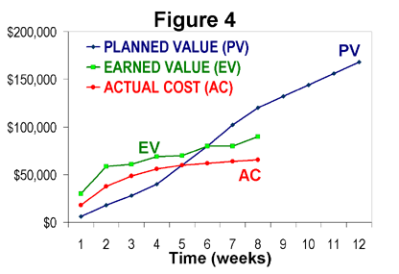
Planned Value, Earned Value and Actual cost

Slide 18
Final consideration
The most important need for good estimate is an estimation group
This group should
Ensure that estimates and actuals are stored in a database
Analyse & establish productivity factors & contingencies
Progressively improve estimates as more data is gathered and analysed
Assist development groups in preparing plans

Slide 19
Homework
What the estimation methods are used in your organizations
What are the productivity factors?

Slide 20
Appendix

